Slide 1

GET STARTED WITH GIT-GITHUB
CODING CLUB SVIT

Slide 2
AGENDA
Create your own Git repo, make commits to track changes
Collaborate with others by pushing and pulling changes between repos, making pull requests, and merging them
Learn about Git’s branching model and how to work on multiple changes simultaneously
Move commits around between branches, move branches around within repos
Travel through time and change history in your repo
➤
➤
➤
➤
➤

Slide 3
What is GIT ?
Git is like a really epic save button for your files and directories.
Git is a version control system.
It allows you to see changes you make to your code and easily revert them
It is NOT Github
➤
➤
➤
➤

Slide 4
What is GITHUB ?
Github.com is a website that hosts git repositories on a remote server
Hosting repositories on Github facilitates the sharing of codebases among teams by providing GUI to easily fork or clone repos to a local machine
➤
➤

Slide 5
WHAT IS VERSION CONTROL?
➤
Ability to always go back to an old version
Track metadata about changes: who, when, and why?
Allow multiple editors to make changes simultaneously without stepping on each others’ toes
➤
➤
Sadly, version control is not often taught in school. Therefore, I will assume that this is all new for you.
If you’ve done version control before: great! Refresh your knowledge.

Slide 6








CENTRALIZED VCS
➤
One central repository
Many partial copies, one for each editor
Partial copies can download updates from central repo, and send changes to central repo (if changes don’t conflict)
Partial copies never talk to each other directly
Examples: CVS, Subversion, ClearCase, Perforce
Central Repository
➤
➤
changes
➤
Partial copy
Partial copy
Partial copy
Partial copy
➤

Slide 7
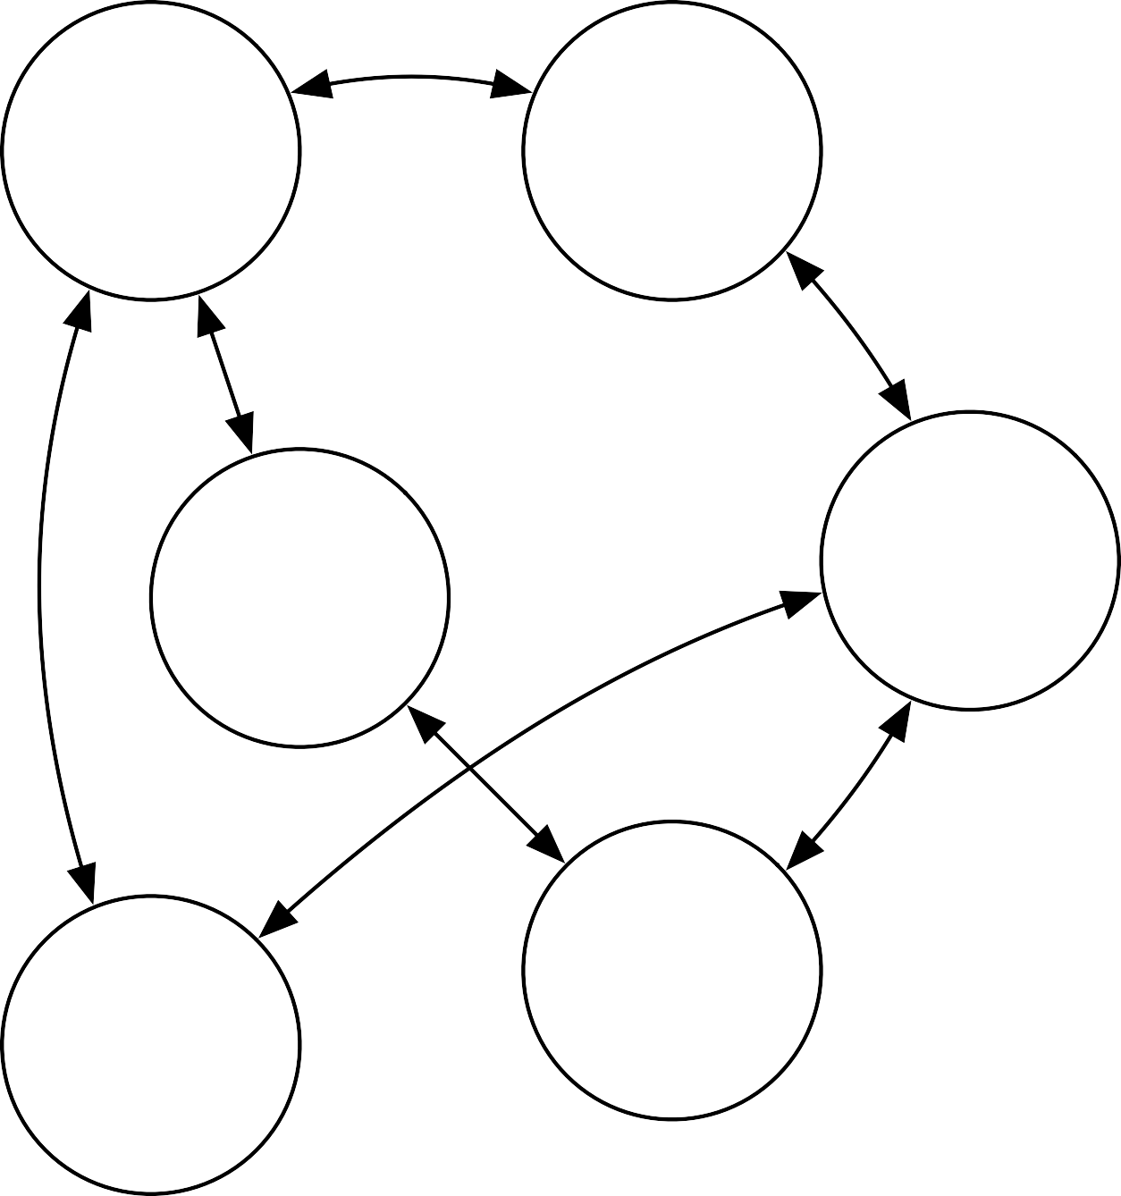
DECENTRALIZED VCS
➤
Every editor has a copy of the entire repository, including all history for the project
Every repo has its own owner & permissions: forking is common
Central repository is not necessary — however, some teams choose to designate one repo as the “main” one
Examples: Git, Mercurial
Repo
Repo
➤
Repo
Repo
➤
Repo
Repo
➤

Slide 8
Join the Coding Club at SVIT: Unlock Your Potential!
Hands-on coding sessions to apply theoretical knowledge into practical projects.
Regular meetups and social events to connect with like-minded individuals and build lasting relationships.
Collaborative coding projects fostering teamwork and creativity.
Enhance Your resume with Coding club Experience.
➤
➤
➤
➤

Slide 9
THE BASICS
Create a repo, make some commits

Slide 10
MAKE A REPO
$ git init cookbook
➤
git init creates a new, empty repo
Optional argument is the name of the directory to create; otherwise the repo will be created in the current directory
Creates a .git directory that stores all the repo information
➤
➤

Slide 11
WINDOWS COMMANDS
Commands
Dir : Directory listing
Mkdir: To make a new directory
Cd : change the current directory
cd..: to exit current directory
Echo: to print something on screen

Slide 12

EXPLORE THE REPO
$ ls .git HEAD
config
info/ objects/
description refs/ hooks/
Mostly, you shouldn’t need to touch the contents of the
.git directory, but there is one very useful file: .git/config

Slide 13
GIT CONFIG
$ git config <key> [<value>]
➤
git config allows you to read and write values to Git’s config files
By default, it uses .git/config
Use the --global flag to use ~/.gitconfig
You’ll need to set your name and email address:
➤
➤
$ git config --global user.name "Joe Developer"
$ git config --global user.email "joe@example.com"

Slide 14
MAKE A FILE
➤
Find a delicious recipe, copy the text, paste it into a file in your “cooking” Git repo. For example:
S'mores Recipe | smores.txt
Ingredients: 1 large marshmallow 1 graham cracker 1 bar of chocolate Directions: Heat the marshmallow over an open flame until it begins to brown and melt. Break the graham cracker in half. Sandwich the chocolate between the cracker and the hot marshmallow. Allow the marshmallow to cool a moment before eating.

Slide 15
GIT STATUS
$ git status
➤
git status tells you the status of the files in your repo: what is new, what has changed, what’s been deleted
git status is always safe to run, and will never change or break anything in your repo
My most frequently used Git command!
➤
➤

Slide 16
GIT ADD
$ git add smores.txt
➤
git add tells Git that you want a certain file added to the repository in an upcoming commit
Marks the file to be included as it is at that point in time. Picks up on changes since the last commit, but won’t pick up on changes you make after running git add — you’ll need to re-add the file to include those changes!
Adding a directory will add all files in that directory. Use git add . to add all files at once!
➤
➤

Slide 17
GIT COMMIT
$ git commit
➤
git commit creates a new commit based on the files you’ve marked using git add
A commit message is required: Git will open your text editor so you can write one
You can use the -m flag to provide a message on the command line, instead
➤
➤

Slide 18
COMMITTING CHANGES
To commit a change to the repo, do the following:
➤
Edit files and save changes
➤ git add <files>
➤ git commit
Special case: to delete a file from the repo, use
$ git rm <file>
exactly like how you would use git add

Slide 19
COMMANDS FOR MAKING COMMITS
➤ | git | init
➤ | git | status
➤ | git | add <file>
➤ | git | rm <file>
➤ | git | commit

Slide 20
VIEWING THE COMMIT LOG
$ git log
➤
git log displays a log of all the commits, from most recent to least recent
Use the arrow keys to scroll, press “Q” to quit
➤

Slide 21
GIT SHOW
$ git show <hash>
➤
git show displays detailed information about a particular commit
The hash argument is optional, defaults to current commit Use the arrow keys to scroll, press “Q” to quit
➤
➤

Slide 22
VIEWING A DIFF
$ git diff
➤
git diff shows the changes you’ve made that haven’t yet been committed
Useful for checking to be sure that you’ve made all the changes you intend, and none of the ones you didn’t
Use the --staged argument to view changes that you’ve already added using git add
Use the arrow keys to scroll, press “Q” to quit
➤
➤
➤

Slide 23
BROWSING HISTORY
$ git checkout <hash>
➤
git checkout allows you to view your project as it was at a particular commit
You will get a big scary “detached HEAD” warning: ignore it for now
To get back to your most recent commit, use master
instead of a hash, like this:
➤
➤
$ git checkout master
Do this before making any new commits!

Slide 24
COMMANDS FOR VIEWING COMMITS
➤ | git | log
➤ | git | show
➤ | git | diff
➤ | git | checkout

Slide 25
ALL THE GIT COMMANDS WE KNOW SO FAR
making commits
viewing commits
git git git git | init config status add |  | git git git git | log show diff checkout
git git | rm commit

Slide 26
COLLABORATION
Sharing commits across repos

Slide 27
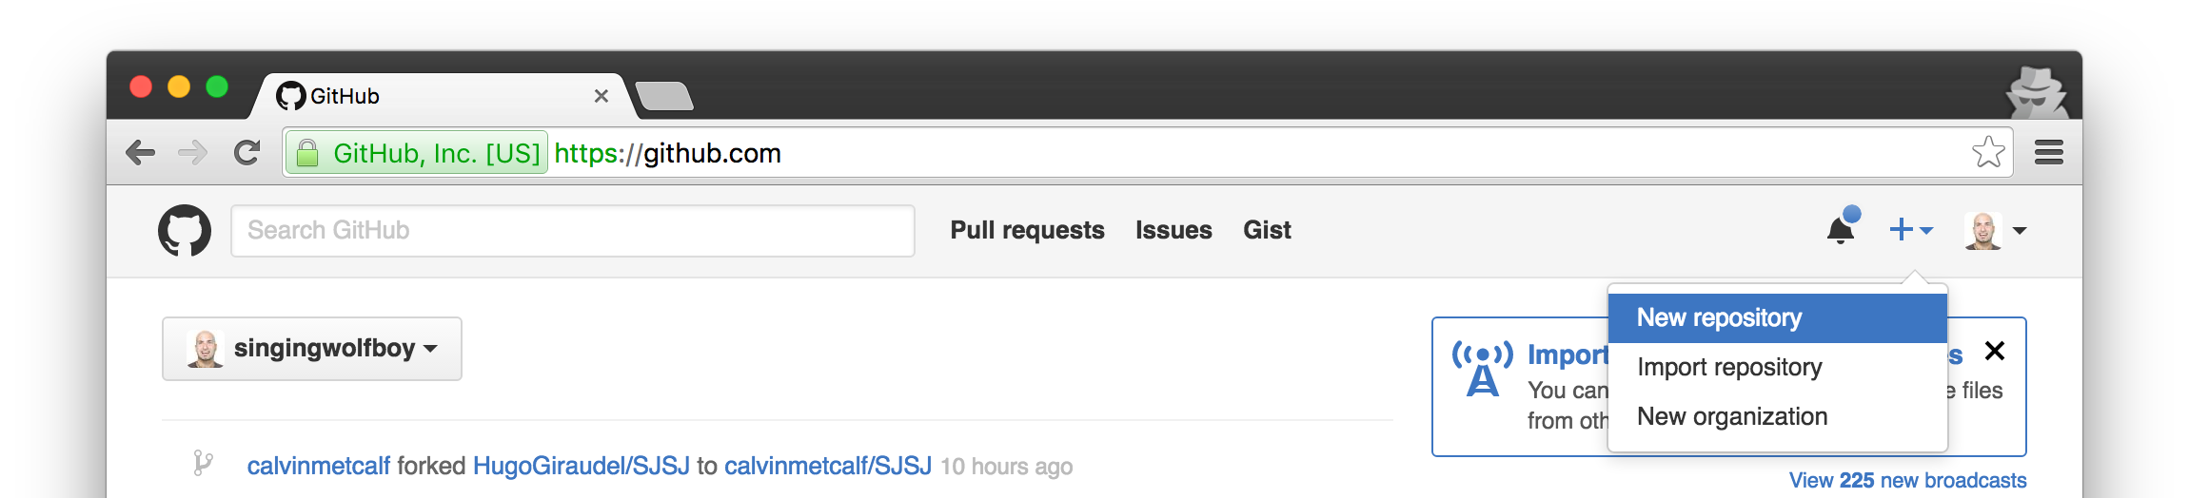
CREATE REPO ON GITHUB
➤
Visit GitHub.com, log in, and click on the plus sign at the top to make a new repository

Slide 28
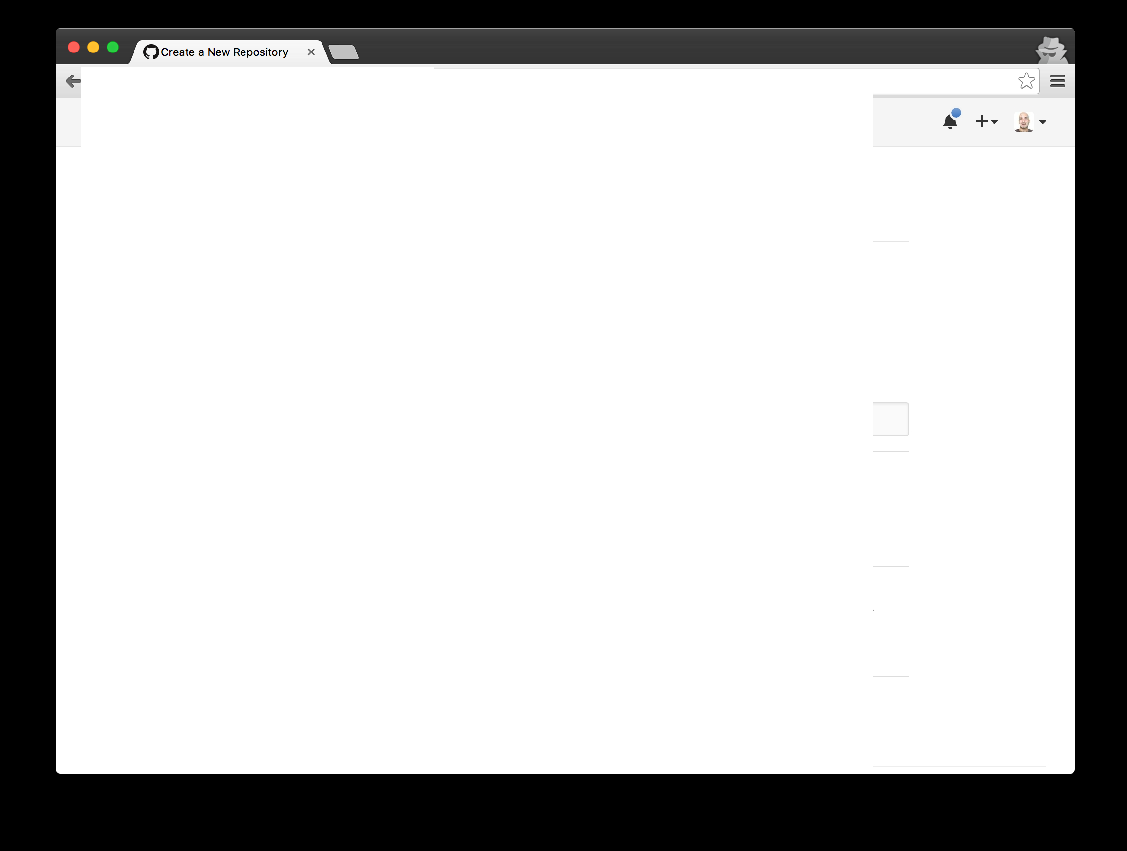
C [[{5 GitHub, Inc. [USJ] https://github.com/new
0 Search GitHub
Pull requests
Issues
Gist
Create a new repository
A repository contains all the files for your project, including the revision history.
Owner Repository name
- singingwolfboy .... / cookbook
Great repository names are short and memorable. Need inspiration? How about psychic-chainsaw. Description (optional)
Keep track of all my favorite recipes!
0 | f7 | Public
 |  | Anyone can see this repository. You choose who can commit.
0 |  | Private You choose who can see and commit to this repository.
0 Initialize this repository with a README
This will let you immediately clone the repository to your computer. Skip this step if you're importing an existing repository.
Add .gitignore: None ....
Add a license: None .... ©
Create repository

Slide 29
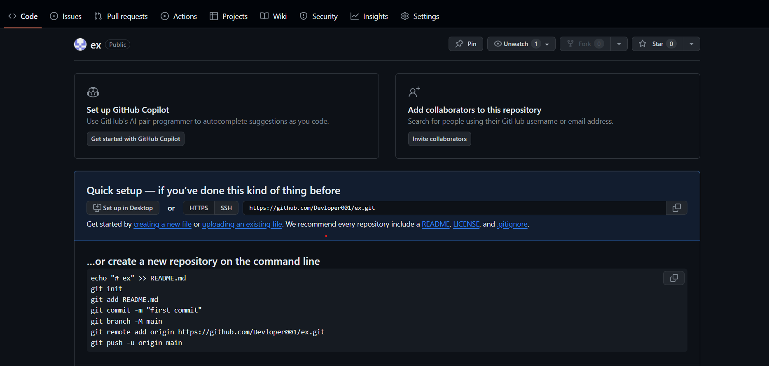

Slide 30
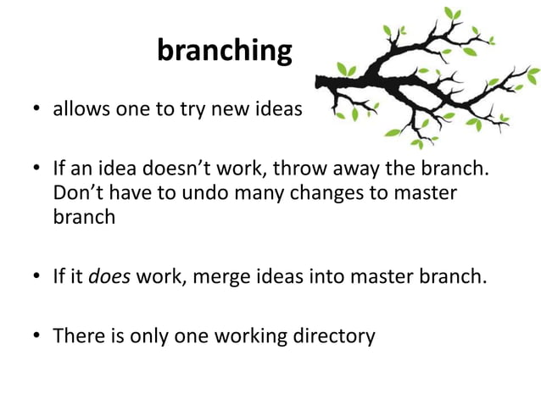

Slide 31
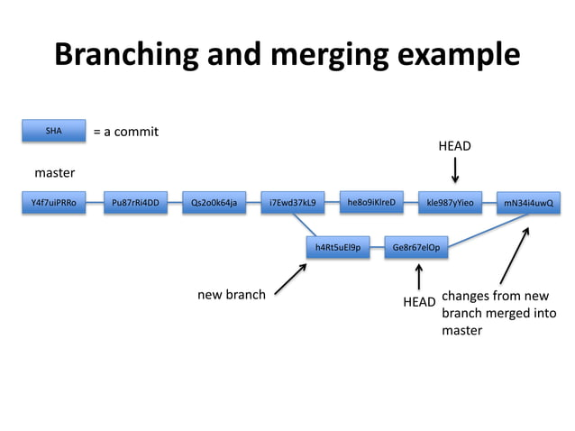

Slide 32
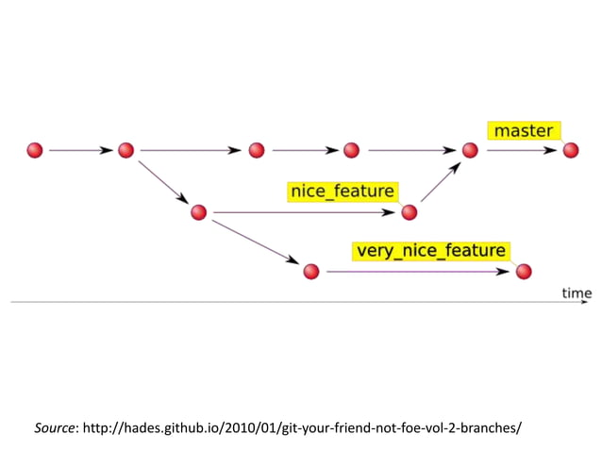

Slide 33
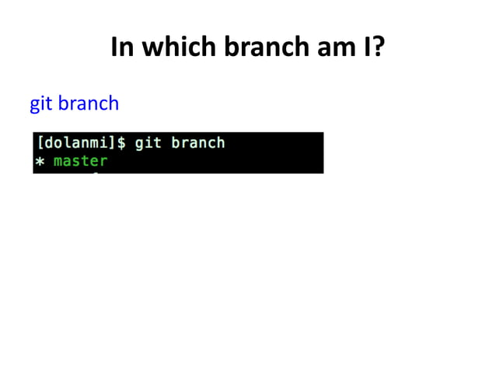

Slide 34
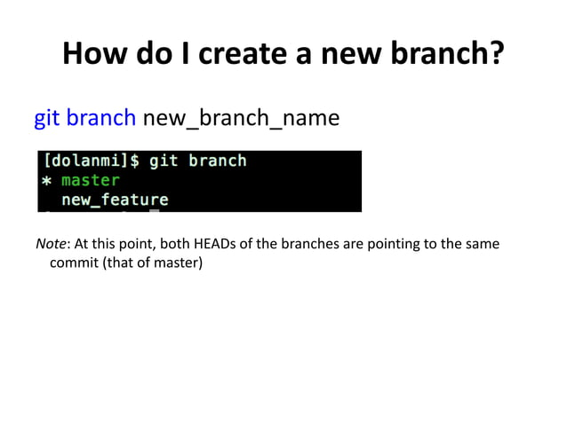

Slide 35
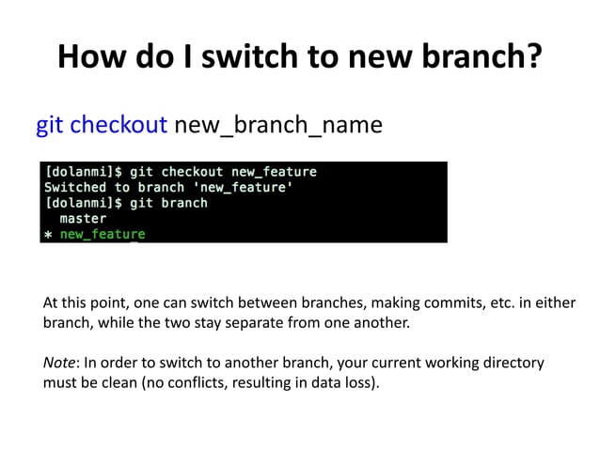

Slide 36
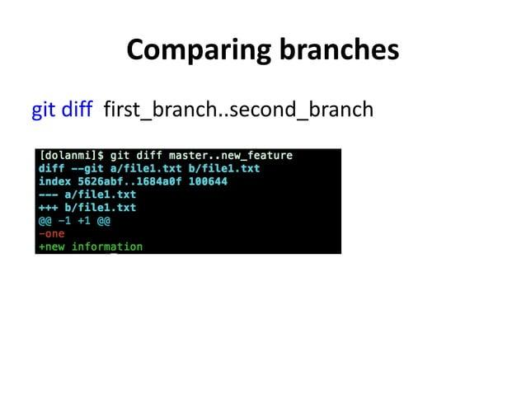

Slide 37
GIT REMOTES
$ git remote add <name> <url>
➤
git remote creates short nicknames for URLs that point to other Git repos that you want to share commits with
Run git remote -v to list all the remotes that the repo knows about Remotes are saved in the .git/config file: you can edit it, if you want
➤
➤

Slide 38
GIT PUSH
$ git push
➤
git push sends commits from your repo to another repo
Can specify a remote; if not, pushes to whatever remote is set as default
➤
$ git push -u origin master
This is what GitHub tells you to run
➤
-u origin sets the “origin” remote as the default remote
master is a branch, and it’s the same thing we use to get back to the most recent commit. We’ll learn about branches in a little bit.
➤

Slide 39
GIT CLONE
$ git clone <url>
➤
git clone makes a local copy of a repo that is available at the given URL
The local copy is a full, complete repo, with all commits and history
Local copy has a remote named origin, which is set to the original URL
The local copy is yours: you can change it however you want!
➤
➤
➤
Taking an existing project and making your own changes is called “forking”, and it happens all the time with Git

Slide 40
COMMANDS FOR COLLABORATION
➤ | git | clone
➤ | git | remote
➤ | git | push
➤ | git | pull
➤ | git | fetch
➤ | git | merge

Slide 41
ALL THE GIT COMMANDS WE KNOW SO FAR
making commits
viewing commits
collaborating
git | init |  | git | log |  | git | clone
git | config |  | git | show |  | git | remote
git | status |  | git | diff |  | git | push
git | add |  | git | checkout |  | git | pull
git git | rm commit |  |  |  |  | git git | fetch merge

Slide 42
PULL REQUESTS
Fork the repo, so you have control over your fork
Make commits in your fork to change it however you want
Contact the owner of the upstream repo, show your changes, ask the owner to pull your changes into upstream repo
GitHub has a special interface for managing these requests, which they call Pull Requests

Slide 43
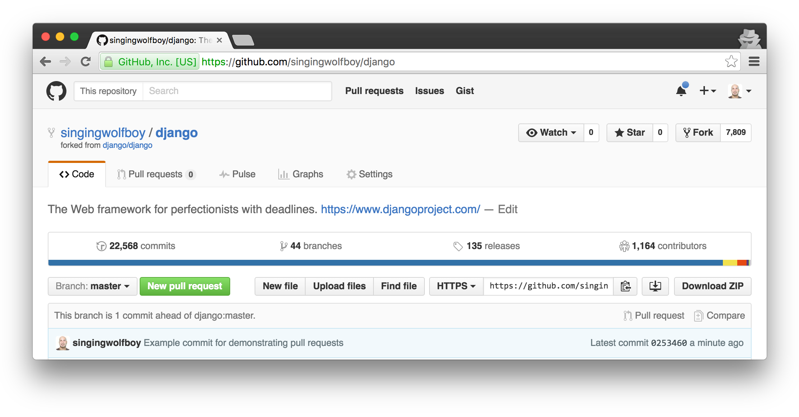


Slide 44
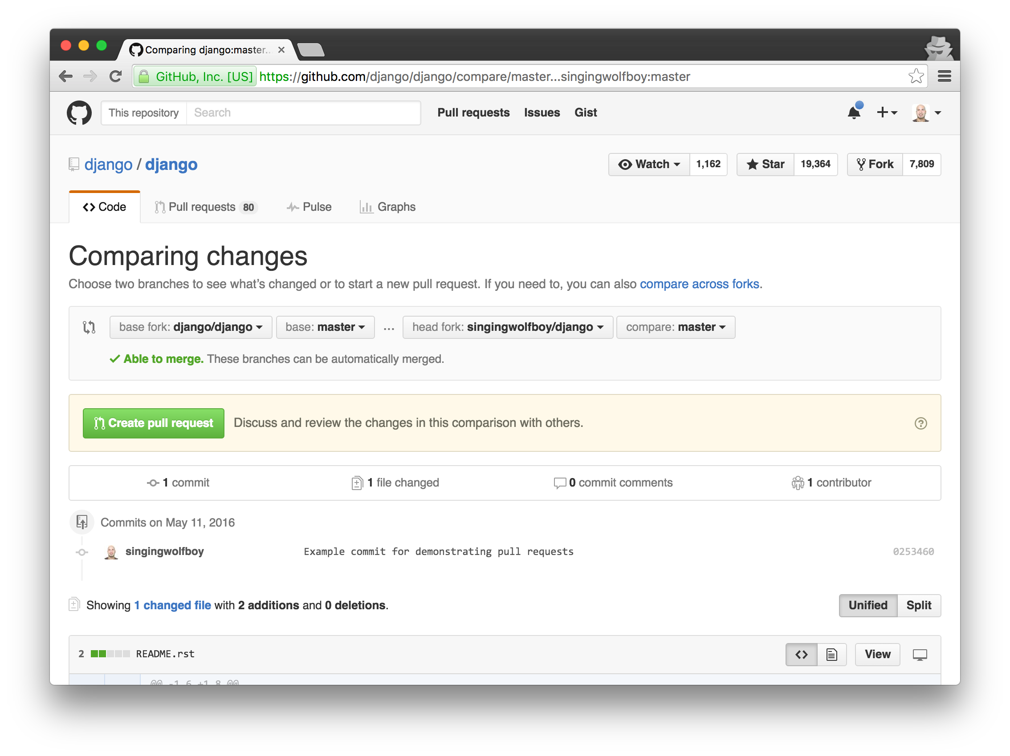


Slide 45
MAKING PULL REQUESTS
➤
Fork the repo at https://github.com/singingwolfboy/tutorial-cookbook
Clone your forked repo to your computer
In your forked repo, create a new file with a new recipe, and commit it
Push your commit to your fork on GitHub
Make a pull request from your fork to my repo (known as the “upstream” repo)
➤
➤
➤
➤

Slide 46
MERGING PULL REQUESTS
➤
Can use the merge button on a GitHub pull request
OR, do it manually with Git:
➤
➤
Add requester’s fork as a remote
➤ git | fetch | <remote>
➤ git | merge | <remote>/master
➤ git | push
➤
GitHub will automatically update the pull request!
Remember, “git pull” is “git fetch” followed by “git merge”,
so in this case, I’m being more explicit about what I merge with

Slide 47

OTHER GIT HOSTING
GitHub is not the only website you can use to host repos
GitLab, BitBucket: free private repos
GitLab is open source: can run it on your own server
It’s all Git, so you can clone from GitHub and push to GitLab (or vice versa)
➤
➤
➤
➤

